Slide 1
Creating & Using Rubrics to Examine Learning & Development
Derek Meyers & Ryan Smith
University Assessment Services
March 20, 2018
Center for Teaching, Learning & Technology Resource Commons

Slide 2
Questions
Do you know what a rubric is?
Do you use rubrics?
Do you have an opinion about rubrics?

Slide 3
Definition of a Basic Rubric
A rubric is a scoring tool that lays out specific expectations for an assignment or project. It lists the things you look for when evaluating student work.
From University of Rhode Island, General Education Rubrics, June 2015
Notes:
Reflects the best judgment and expertise of faculty at that time.
Is not a technical specification, but a series of choices about what you think is important.
Does not reflect everything that is important.
Think about context. Be aware of using rubrics as evaluative tools.
We will be focusing on rubrics for program evaluation. However, some of the principles apply to classroom rubrics.

Slide 4
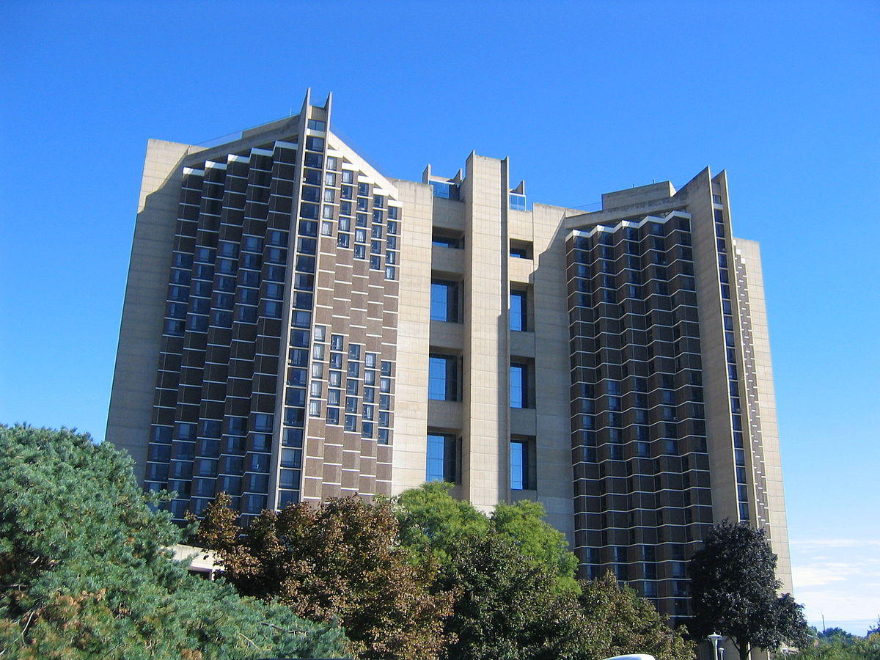
Residence Hall
Outcome:
Personal Life Management Skills in a Residence Hall
Time Management
Respecting Rules & Policies
Room Cleanliness & Safety
Getting Along with Roommate
Respecting Communal Property
Jane
Tom
Bill
Melanie
Four staff assess 20 randomly selected rooms

Slide 5
Checklist Rubric
Bill
Outcome: Personal Management of Life Tasks in a Residence Hall
Area | Present?
Time Management
Respecting Rules & Policies
Room Cleanliness & Safety
Getting Along with Roommate
Respecting Communal Property
Jane
Melanie
Tom

Slide 6
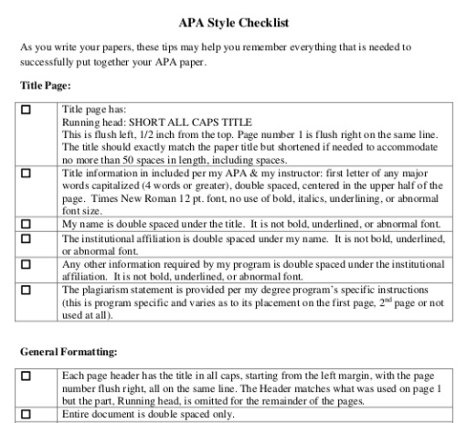
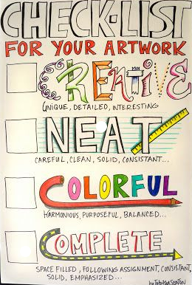
Checklist Rubric
Jonathan Underwood, Tuskegee University, https://www.slideshare.net/JonathanUnderwood1/apa-style-checklist
http://tabithaannthelostsock.blogspot.com/
Notes:
If you are evaluating an assignment or project based solely on whether or not a specific item is included, then a checklist is what you want to use and not a rubric. Other ex: yes/no, true/false, present/absent, etc.

Slide 7
Checklist Rubric Results
Name | Cover Page | Page Numbers | Proper Reference Formatting
Abbie | + | + | -
Bob | + | - | -
Carl | + | + | -
Darlene | + | + | +
….. | ….. | ….. | …..
Total Number of “+” | 20 | 18 | 8
Notes:
If you are evaluating an assignment or project based solely on whether or not a specific item is included, then a checklist is what you want to use and not a rubric. Other ex: yes/no, true/false, present/absent, etc.

Slide 8
Checklist Rubric
Bill
Outcome: Personal Management of Life Tasks in a Residence Hall
Area | Present?
Time Management
Respecting Rules & Policies
Room Cleanliness & Safety
Getting Along with Roommate
Respecting Communal Property
Jane
Melanie
Tom

Slide 9
Rating Scale Rubric
Bill
Outcome: Personal Management of Life Tasks in a Residence Hall
Area | Below Standards | Meets Standards | Exceeds Standards
Time Management
Respecting Rules & Policies
Room Cleanliness & Safety
Getting Along with Roommates
Respecting Communal Property
Jane
Melanie
Tom
Notes:
This is helpful because now we can evaluate work

Slide 10
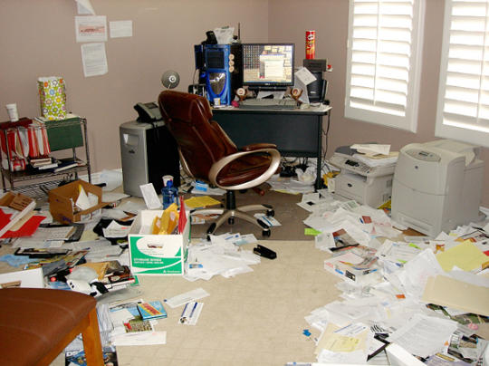
Bill
Jane
Melanie
Tom

Slide 11
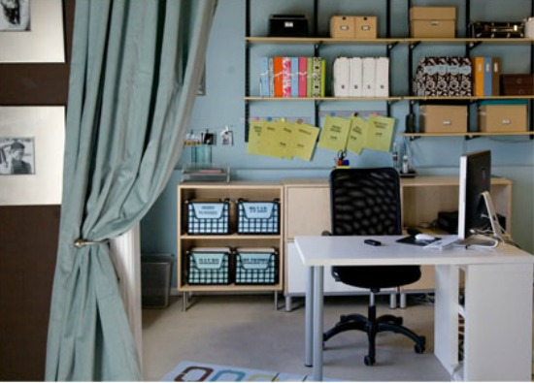
Bill
Jane
Melanie
Tom

Slide 12
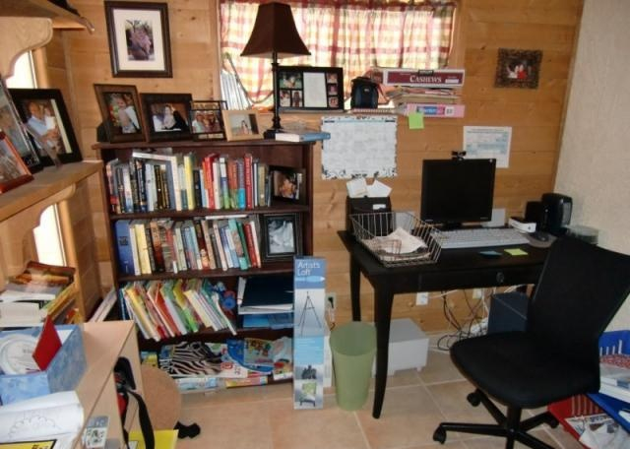
Bill
Jane
Melanie
Tom

Slide 13
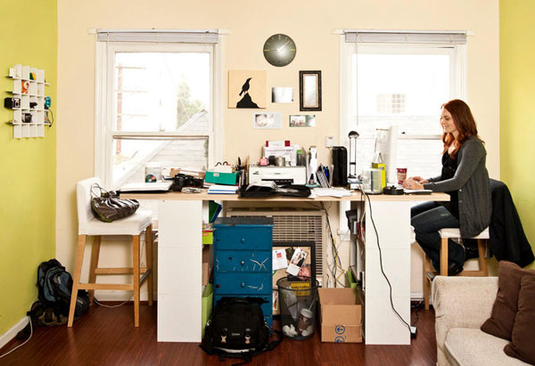
Bill
Jane
Melanie
Tom

Slide 14
Rating Scale Rubric Results
Bill
Jane
Melanie
Tom
Notes:
Exposes a limitation to Rating Scale data:
Faculty and staff can be inconsistent in terms of how they evaluate assignments or projects.
Provides vague feedback.

Slide 15
Descriptive Analytic Rubric
Performance Levels
Bill
Area | Below Standards - 1 | Meets Standards - 2 | Exceeds Standards - 3 | Score
Safety | Loose electrical cords, evacuation procedures missing | Cords loose but routed along wall, evac procedures covered | Electrical cords properly tied, evac procedures visible
Sanitation | Visible and open garbage | Garbage contained, but not taken out | No visible garbage, all contained
Light, heat and ventilation | Vents covered with obstructions (laundry, papers, etc.). | Vents open and unobstructed | Vents open, unobstructed, and clean
Criteria
3
Jane
2
Melanie
3
Criteria Descriptions
Tom

Slide 16
Descriptive Analytic Rubric Results
Bill
Jane
Melanie
Tom

Slide 17
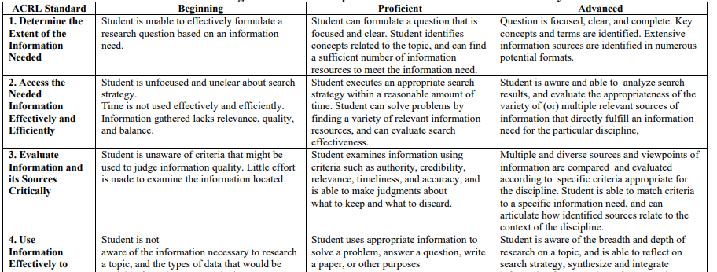
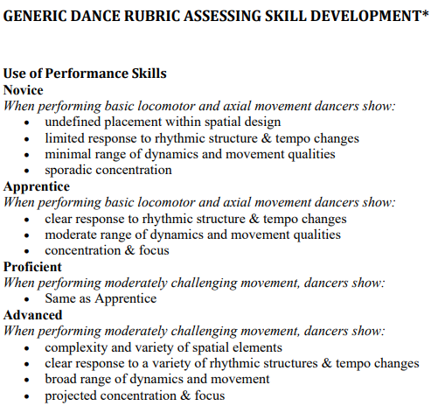
Descriptive Analytic Rubric: Examples
California State University, Information Competence Initiative
Connie Schroeder, University of Wisconsin-Milwaukee

Slide 18
Holistic Rubric
Task: Assessing Student Essays for Writing
Scale | Description | Score
Inadequate | The essay has at least one serious weakness. It may be unfocused, underdeveloped, or rambling. Problems with the use of language seriously interfere with the reader’s ability to understand what is being communicated. | 1
Developing Competence | The essay is somewhat unfocused, underdeveloped, or rambling, but it does have some coherence. Problems with the use of language occasionally interfere with the reader’s ability to understand what is being communicated. | 2
Acceptable | The essay is generally focused and contains some development of ideas, but the discussion may be simplistic or repetitive. The language lacks syntactic complexity and may contain occasional grammatical errors, but the reader is able to understand what is being communicated. | 3
Sophisticated | The essay is focused and clearly organized, and it shows depth of development. The language is precise and shows syntactic variety and ideas are clearly communicated to the reader. | 4
Adapted from Mary Allen, Assessing Academic Programs in Higher Education
Notes:
Instead of looking at components of an assignment, evaluating the assignment as a whole.

Slide 19
Holistic Rubric Results
Notes:
Rubric mistakes
Inconsistent performance criteria
Vague descriptors

Slide 20
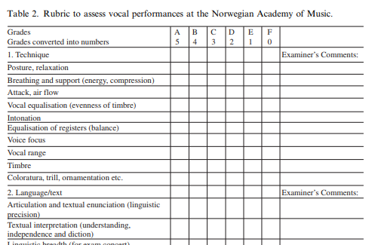
Gynnild, V. (2016). Assessing Vocal Performance Using Analytical Assessment: A Case Study. Music Education Research, 18, 224-238.

Slide 21
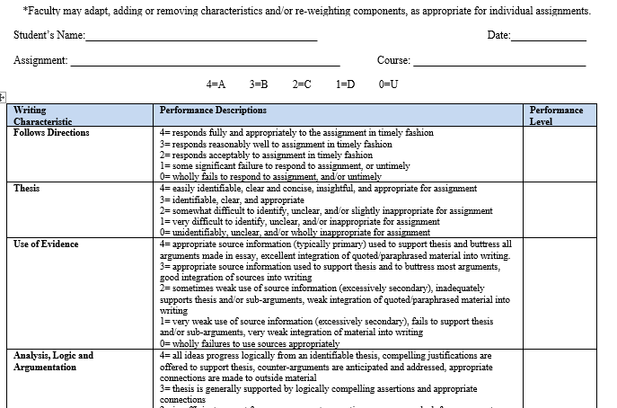
Fort Hays State University (KS), Political Sci. Dept.

Slide 22
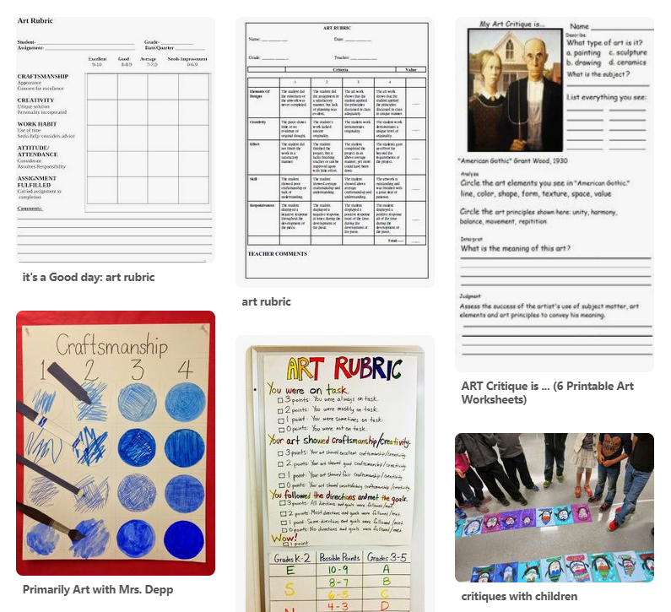
Pinterest, https://www.pinterest.com/daartistee/art-assessments-rubrics/?lp=true

Slide 23
Task: Assessing a Science Journal
Performance Criteria | Attribute | Novice | Apprentice | Master | Expert
Problem Criterion
Science Journal | (not stated) | Writing is messy and entries contain spelling errors. Pages are out of order or missing. | Entries are incomplete. There may be some spelling or grammar errors. | Entries contain most of the required elements and are clearly written. | Entries are creatively written. Procedures and results are clearly explained. Journal is well organized and presented.
From Tierney, R., & Simon, M. (2004). What’s Still Wrong with Rubrics: Focusing on the Consistency of Performance Criteria Across Scale Levels. Practical Assessment, Research, and Evaluation, 9. Online: http://pareonline.net/getvn.asp?v=9&n=2

Slide 24
How to Design a Rubric
Look for other rubrics
Select the project/assignment to which the rubric will be applied
Identify performance criteria
Set performance levels (below, meets, exceeds, etc.)
Create performance descriptions – start with “A” or “exemplary” work
Pilot and experiment with the rubric

Slide 25
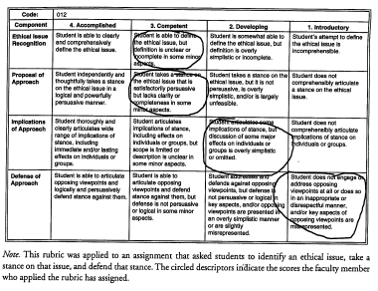
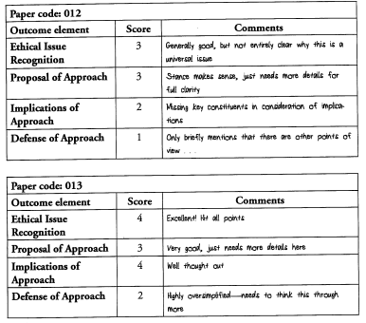
Using the Rubric

Slide 26
Checklist Rubric
Outcome: Presentation Skills
Minimal text
Clearly labeled tables and figures
Appropriate color scheme (no bright or mismatched colors, minimal background, etc.).
Numbered slides or handouts
Appropriate pace
Available hard copies
Audience engaged
Length of presentation is appropriate
Jonathan Underwood, Tuskegee University, https://www.slideshare.net/JonathanUnderwood1/apa-style-checklist

