Slide 1
Developing & Aligning Outcomes with Curricula & Programs
Derek Meyers & Ryan Smith
University Assessment Services
March 6, 2018
Center for Teaching, Learning & Technology Resource Commons

Slide 2
Questions
What is a curriculum?
What should a curriculum include?
What does a good curriculum look like?

Slide 3
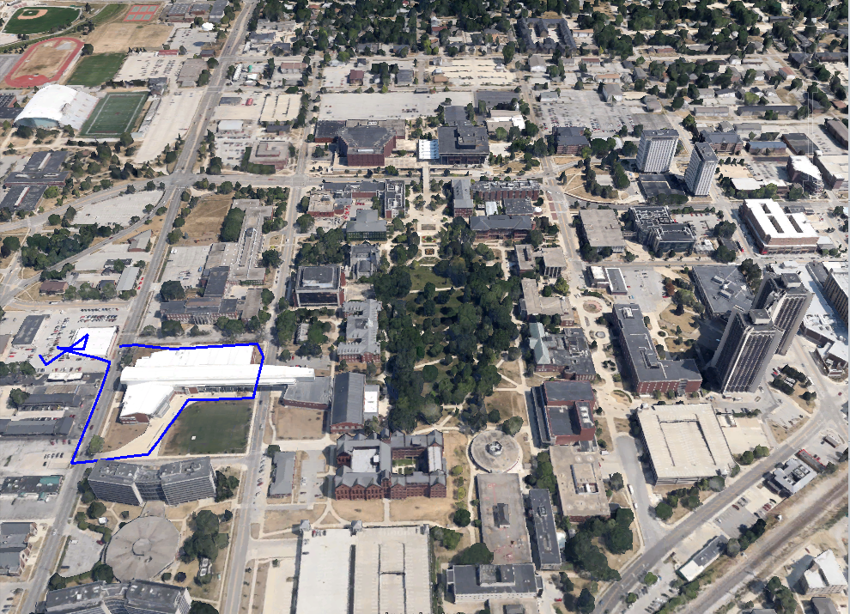
Our Experience

Slide 4
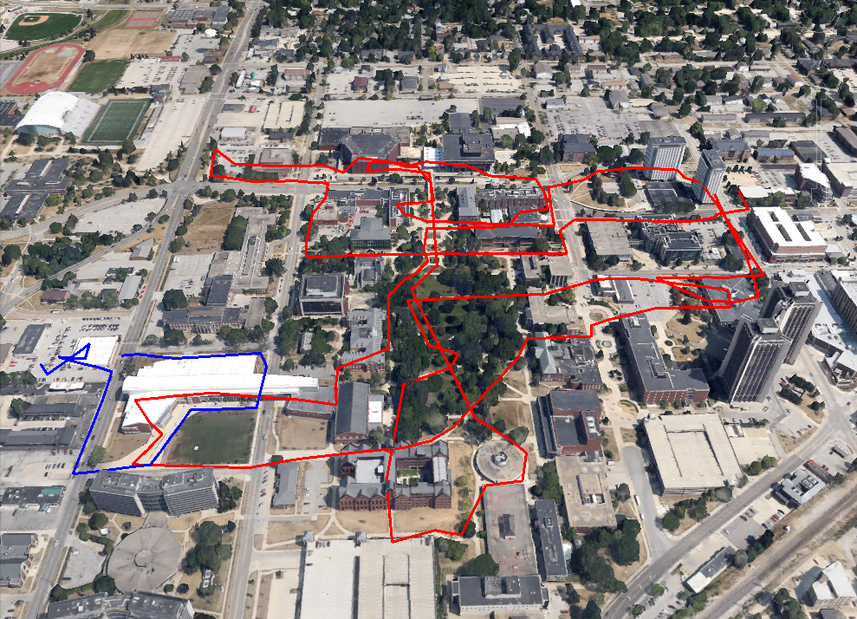
Students’ Experience

Slide 5
Alignment
Is how & where students learn just as important as what students learn?
Alignment = curriculum + instruction + assessment
A blueprint
An articulation of where and how learning occurs.
A tool for aligning courses with goals or outcomes, or intentions with actions.

Slide 6
Basic Curriculum Map
Common Courses | GOALS OR OUTCOMES
 | Goal 1 | Goal 2 | Goal 3 | Goal 4
111 | X |  |  | X
138 |  | X | X
200 | X |  |  | X
231 |  | X | X | X
331 | X |  | X
340 |  | X |  | X
392 | X | X | X | X

Slide 7
Basic Co-curriculum Map
Units | GOALS OR OUTCOMES
 | Identity Development | Health & Wellness | Civic Responsibility | Global Awareness
Campus Dining | X | X |  | X
Campus Housing |  | X
Campus Recreation |  | X
Student Organizations |  |  | X | X
Student Health Services |  | X
Career Center | X

Slide 8
Assessment Map: Assessments in Cells
COMMON PROGRAM COURSES | OUTCOMES
 | Outcome 1: Analyze and identify materials from which historical period they are made | Outcome 2: Analyze the conservation needs of an object | Outcome 3: Design and administer a museum budget. | Outcome 4: Develop appropriate research skills
Art History 101 | Common Exam questions
Art History 110 |  | Common Exam questions | Common Exam questions
Internship |  | Museum Admin. Evaluation | Museum Admin. Evaluation
Attendance at college art events | Term Paper |  |  | Term Paper
Art History 490: senior capstone | Final Project |  | Final Project | Final Project

Slide 9
Assessment Map: Activities in Cells
COMMON PROGRAM ASSESSMENT | OUTCOMES
 | Outcome 1: Analyze and identify materials from which historical period they are made | Outcome 2: Analyze the conservation needs of an object | Outcome 3: Design and administer a museum budget. | Outcome 4: Develop appropriate research skills
Common Exam Questions | AH 101 | AH 110 | AH 110
Museum Admin. Eval. |  | Internship | Internship
Term Paper | College art events |  |  | College art events
Final Project Rubric | AH 490 |  | AH 490 | AH 490

Slide 10
Assessment Map: Co-Curricular
Units | OUTCOMES
 | Identity Development | Health & Wellness | Civic Responsibility | Global Awareness
Campus Dining |  | Healthy Eating Initiative Evaluation
Campus Housing | EBI Survey | EBI Survey |  | EBI Survey
Campus Recreation | Leadership Survey (Adv. Programs) | Tracking Use
Student Organizations | NSSE |  | Program Evaluation
Student Health Services |  | Patient Satisfaction and Follow-up Surveys

Slide 11
Learning Environment Maps
Common Courses and Experiences | Prior Learning | Required Courses | Recommended Electives | Activities and Experiences that Support Learning Outcomes (co-curricular) | Work-based Learning Experiences | Certifications & Licensures | Possible Career Paths & Life Outcomes | Learning-identified Experiences
Apply the scientific method | x |  |  |  |  |  |  | x
Develop laboratory techniques |  |  | x | x | x | x
Diagram and explain major cellular processes |  | x | x |  |  |  | x | x
Awareness of careers and job opportunities in biological sciences |  |  |  | x | x |  |  | x
From Jankowski, N., & Marshall, D. (2017). Degrees That Matter: Moving Higher Education into a Learning Systems Paradigm. Sterling, VA: Stylus.

Slide 12
Degree Level Maps
Common Courses and Experiences | General Education | Major Courses | Activities & Experiences that Provide Support (Co-curricular) | Possible Career Paths & Life Outcomes
Apply the scientific method | x
Develop laboratory techniques |  |  | x | x
Diagram and explain major cellular processes |  | x | x
Awareness of careers and job opportunities in biological sciences |  |  |  | x
From Jankowski, N., & Marshall, D. (2017). Degrees That Matter: Moving Higher Education into a Learning Systems Paradigm. Sterling, VA: Stylus.

Slide 13
Developmental Maps
Common Courses and Experiences | Program Learning Outcomes
 | Apply the scientific method | Develop laboratory techniques | Diagram and explain major cellular processes | Awareness of careers and job opportunities in biological sciences
BIOL 101 | Introduced | Introduced |  | Introduced
BIOL 202 | Developed | Developed | Introduced
BIOL 303 | Developed | Developed Mastered | Developed
BIOL 404 | Mastered |  | Mastered | Developed
Other: Exit interview |  |  |  | Assessed

Slide 14
Developmental Maps
Units | OUTCOMES
 | Identity Development | Health & Wellness | Civic Responsibility | Global Awareness
Campus Dining | Low Emphasis | High Emphasis | Medium Emphasis | Low Emphasis
Campus Housing | High Emphasis | High Emphasis | Low Emphasis | Low Emphasis
Campus Recreation | Medium Emphasis | High Emphasis | Low Emphasis | Low Emphasis
Student Organizations | Medium Emphasis | Medium Emphasis | High Emphasis | Low Emphasis
Student Health Services | Low Emphasis | High Emphasis | Low Emphasis | Low Emphasis
Campus Quidditch Program | Low Emphasis | Low Emphasis | Low Emphasis | Low Emphasis

Slide 15
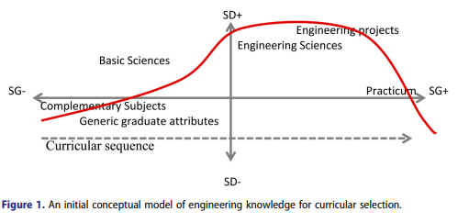
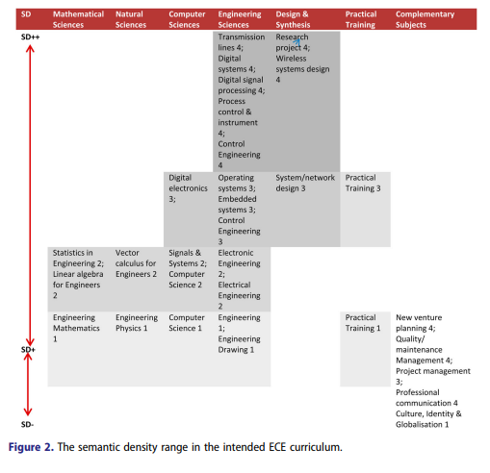
Winberg, C. (2016). I Take Engineering with Me: Epistemological Transitions across an Engineering Curriculum. Teaching in Higher Education, 21, 398-414.

Slide 16
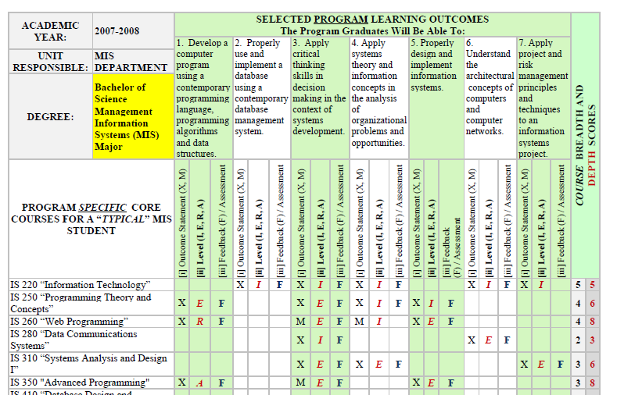
Veltri, N., et al. (2011). Curriculum as a Tool for Continuous Improvement of Information Systems Curriculum. Journal of Information Systems Education, 22, 31-42.

Slide 17
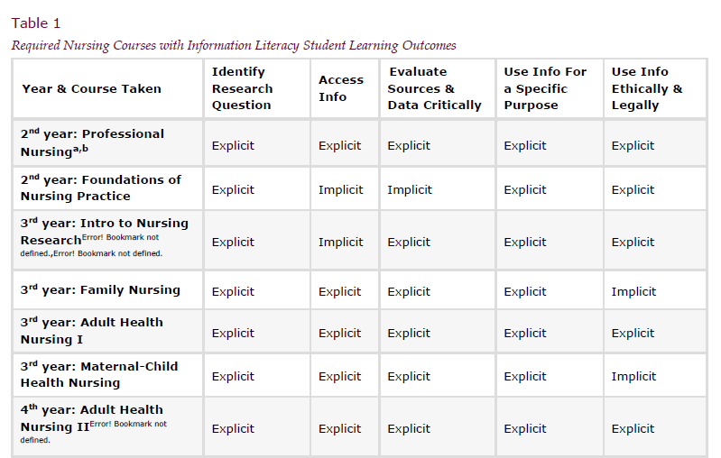
Miller, M., & Neyer, N. (2016). Mapping Information Literacy and Written Communication Outcomes in an Undergraduate Nursing Curriculum: A Case Study in Librarian-Faculty Collaboration.

Slide 18
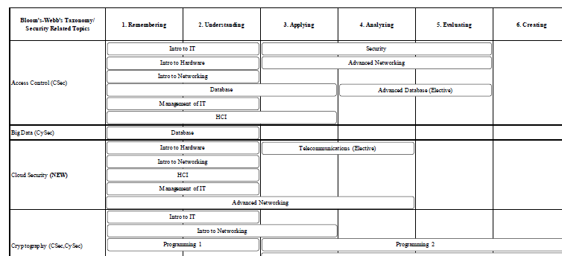
Harris, M., & Patten, K. (2015). Using Bloom’s and Webb’s Taxonomies to Integrate Emerging Cybersecurity Topics into a Computing Curriculum. Journal of Information Systems Education, 26, 219-234.

Slide 19
Reading the Map: Example 1
COMMON PROGRAM COURSES & ACTIVITIES | OUTCOMES
 | Outcome 1: Analyze and identify materials from which historical period they are made | Outcome 2: Analyze the conservation needs of an object | Outcome 3: Design and administer a museum budget. | Outcome 4: Develop appropriate research skills
Art History 101 | X | X |  | X
Art History 110 | X | X
Internship | X |  |  | X
Attendance at college art events
Art History 490: senior capstone |  | X |  | X

Slide 20
Reading the Map: Example 2
Courses and Experiences | Program Learning Outcomes
 | Apply the scientific method | Develop laboratory techniques | Diagram and explain major cellular processes | Awareness of careers and job opportunities in biological sciences
BIOL 101 | Introduced |  |  | Introduced
BIOL 202 | Developed |  | Introduced
BIOL 303 | Developed
BIOL 404 | Mastered |  | Mastered
BIOL 454 |  | Mastered

Slide 21
Reading the Map: Example 3
Units | OUTCOMES
 | Identity Development | Health & Wellness | Civic Responsibility | Global Awareness
Campus Dining |  | Healthy Eating Initiative Evaluation
Campus Housing | EBI Survey | EBI Survey |  | EBI Survey
Campus Recreation | Leadership Survey (Adv. Programs) | Tracking Use
Student Organizations | NSSE
Student Health Services |  | Patient Satisfaction and Follow-up Surveys
Social Media Use Survey
Annual Textbook Cost Survey

Slide 22
Benefits
Clarifies relationship between teaching and learning
Helps plan in the context of outcomes, as opposed to activities or processes
Helps develop ideas for new activities or new program implementation
Helps eliminate unproductive or unhelpful activities or assessments
Shows faculty and staff how their area contributes to what students learn at the major level
Fosters collegiality, sharing, and dialog

Slide 23
Suggestions
Emphasize that alignment is not about standardization.
Engage in dialog with colleagues.
Realize that maps take time and are continuous (wikimaps).
Share maps with students.
Avoid over-xing

Slide 24
References
Allen, M. (2004). Alignment (Ch. 3 in Assessing Academic Programs in Higher Education). Bolton, MA: Anker.
Archambault, S., & Masunaga, J. (2015). Strategic Planning & Assessment. J. of Library Admin., 55, 503-519.
Britton, M., et al. (2008). A Curriculum Review and Mapping Process Supported by an Electronic Database System. American J. of Pharmaceutical Ed., 77.
Buchanan, H., et al. (2015). Curriculum Mapping in Academic Libraries. New Rv. of Academic Librarianship, 21, 94-111.
Cuevas, N., Matveev, A., & Miller, K. (2010). Mapping General Education Outcomes in the Major. Peer Review, 12, 10-15.
Harris, M., & Patten, K. (2015). Using Bloom’s and Webb’s Taxonomies to Integrate Emerging Cybersecurity Topics into a Computing Curriculum. J. of Info. Systems Ed., 26, 219-234.
Jankowski, N., & Marshall, D. (2017). Degrees That Matter: Moving Higher Education into a Learning Systems Paradigm. Sterling, VA: Stylus.
Lam, B., & Tsui, K. (2016). Curriculum Mapping as Deliberation. Studies in Higher Ed., 41, 1371-1388.
Massa, L., & Kasimatis, M. (2017). Curriculum & Outcome Mapping (Ch. 4 in Meaningful & Manageable Program Assessment). Sterling, VA: Stylus.
Miller, M., & Neyer, N. (2016). Mapping Information Literacy and Written Communication Outcomes in an Undergraduate Nursing Curriculum.
Suskie, L. (2017). Assessing Student Learning: A Common Sense Guide. San Francisco: Wiley.
Toral, S., et al. (2007). An Electronic Engineering Curriculum Design Based on Concept-Mapping Techniques. Int. J. of Tech. & Design Ed., 17, 341-356.
Veltri, N., et al. (2011). Curriculum as a Tool for Continuous Improvement of Information Systems Curriculum. J. of Info. Systems Ed., 22, 31-42.
Watts, L., & Hodgson, D. (2015). Whole Curriculum Mapping of Assessment: Cartographies of Assessment & Learning. Social Work Ed., 34, 682-699.
Williams, J., & Bolland, K. (2011). Mapping Our Way to Success. Journal of Baccalaureate Social Work, 16, 39-114.
Winberg, C. (2016). I Take Engineering with Me: Epistemological Transitions across an Engineering Curriculum. Teaching in Higher Ed., 21, 398-414.
Zelenitsky, S. (2014). Using Curriculum Mapping to Engage Faculty Members in the Analysis of a Pharmacy Program. Am. J. of Pharmaceutical Ed., 78, 1-9.

